Slide 1
Predicting the best neighborhoods for opening Korean restaurants in Manhattan, New York
A project report by Swapnil Srivastava
May 17th, 2020.

Slide 2
Introduction
The City of New York is famous for its wide variety of diverse cuisine. Its food culture includes an array of international cuisines influenced by the city's immigration history.
Korean restaurants have become very trendy these days in the United States, thanks to K-pop bands, K-dramas and appetizing food they eat (Kimchi and Bibimbap). My personal favorite is Korean BBQ.
Nowadays it seems that there is one Korean joint at every corner of NY, not only in major cities but also in smaller cities. Starting a Korean restaurant can be a great business opportunity, but you need to distinguish yourself from others to enjoy long-term success.

Slide 3
Business Problem
My client wants to open his business in Manhattan area, so I would focus on that borough during my analysis. We define potential neighborhood based on the number of Korean joints which are operating in each neighborhood.
Manhattan has full potential but also is a very challenging district to open a business in the sector because of high competition. New Korean restaurant should be open in an area if the neighborhood which has a smaller number of Korean restaurants. In this way the restaurant can attract more customers.
Therefore, this analysis is necessary to ensure that we have enough customers and that we are not so close to other places having large number of Korean restaurants.

Slide 4
Who would be interested?
My target audience would be stakeholders, who would want to open Korean restaurants in and around Manhattan, New York.
My job would be to accurately determine which places in Manhattan can one setup this business so that it would flourish, and one can make the most profit there.

Slide 5
Date Selection
We would first obtain the dataset of different localities of New York. Only then we can begin our data interpretation based upon the statistics of different locations such as Borough, Neighborhood, Latitude, Longitude etc.
For this we use data sources from Kaggle or from New York public dataset (https://cocl.us/new_york_dataset)
To identify the characteristics of our competitors' venues in Manhattan, we would first need to find out the number of Korean restaurants in Manhattan currently and their location.
We would use Foursquare key value for Korean restaurants to find out different such places operating in Manhattan, New York. (#Korean Restaurant = 4bf58dd8d48988d113941735)
Then we would use Google Map API to find their geographic coordinates based on their geographic location.
We would now group the Korean Restaurant venues by neighborhoods for easy analysis, to checkout which areas have maximum and minimum number of Korean restaurants.
Foursquare API is used to explore neighborhoods in Manhattan, New York.
After that, explore function to get different restaurant categories in each neighborhood.

Slide 6
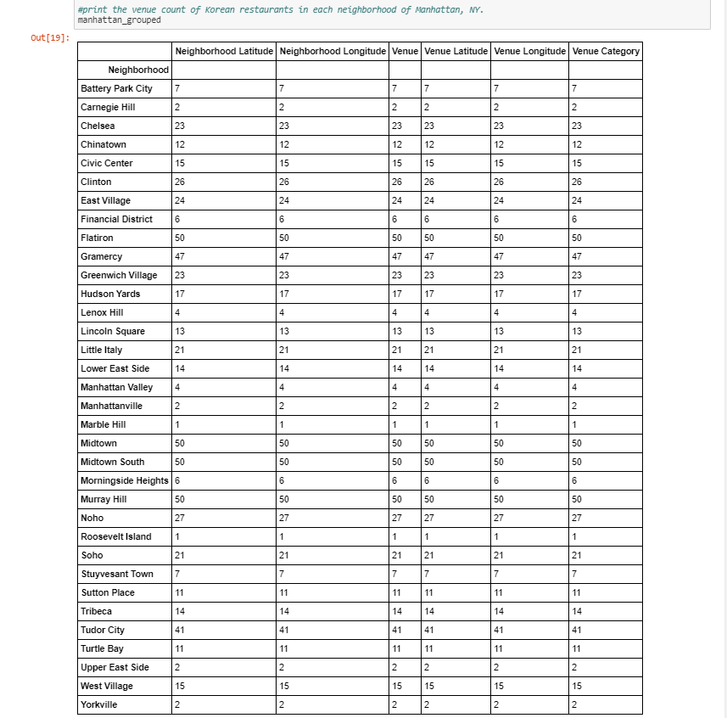

Slide 7
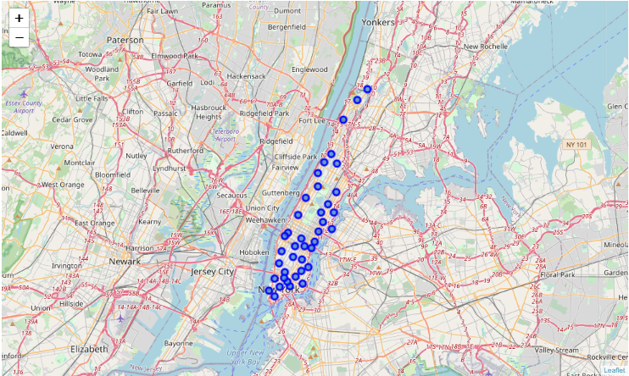
Methodology
Then using this feature to group the neighborhoods into clusters using K-means clustering algorithm will be used to complete this task. Also, the Folium library is used to visualize the neighborhoods in Manhattan and their emerging clusters.
Based on cluster analysis, we would we able to analyze the cluster areas which are the best places to open a new Korean restaurant.
Map of Manhattan, New York showing different neighborhoods.

Slide 8
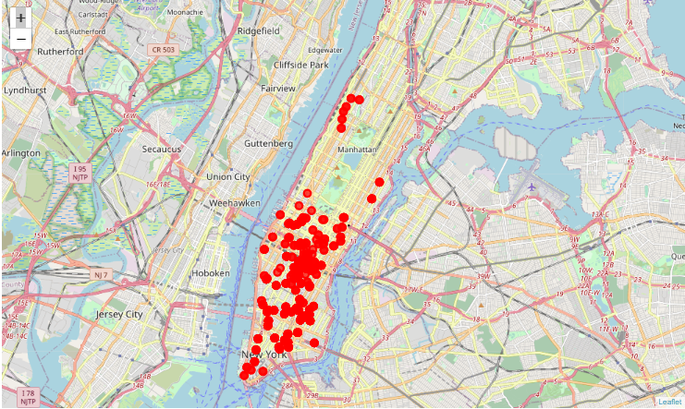
Map showing various Korean restaurants in and around Manhattan, NY.

Slide 9
I have gone for K means algorithm for cluster analysis, particularly because:
K means algorithm is an iterative algorithm that tries to partition the dataset into pre-defined distinct non-overlapping subgroups (clusters) where each data point belongs to only one group. It tries to make the intra-cluster data points as similar as possible while also keeping the clusters as different (far) as possible. It assigns data points to a cluster such that the sum of the squared distance between the data points and the cluster’s centroid (arithmetic mean of all the data points that belong to that cluster) is at the minimum. The less variation we have within clusters, the more homogeneous (similar) the data points are within the same cluster.
The way K means algorithm works is as follows:
Specify number of clusters K.
Initialize centroids by first shuffling the dataset and then randomly selecting K data points for the centroids without replacement.
Keep iterating until there is no change to the centroids. i.e. assignment of data points to clusters isn’t changing.
Compute the sum of the squared distance between data points and all centroids.
Assign each data point to the closest cluster (centroid).
Compute the centroids for the clusters by taking the average of the all data points that belong to each cluster.

Slide 10
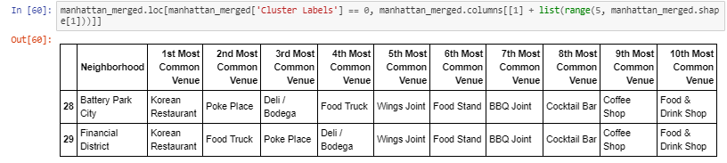
Cluster Label 0

Slide 11
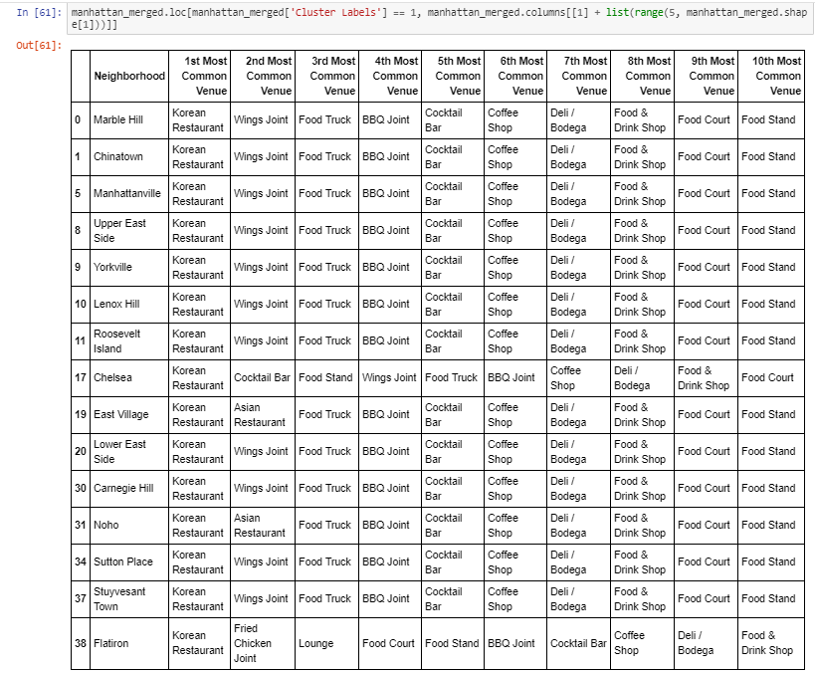
Cluster Label 1

Slide 12
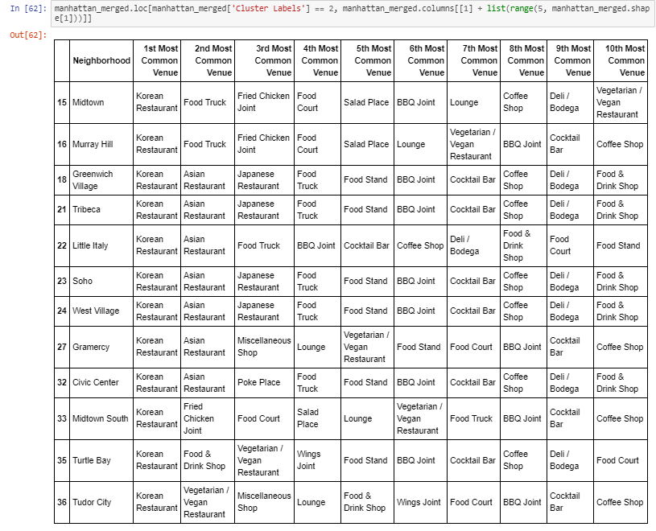
Cluster Label 2

Slide 13
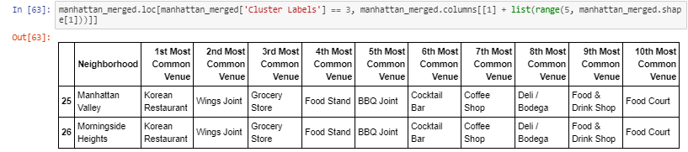
Cluster Label 3

Slide 14
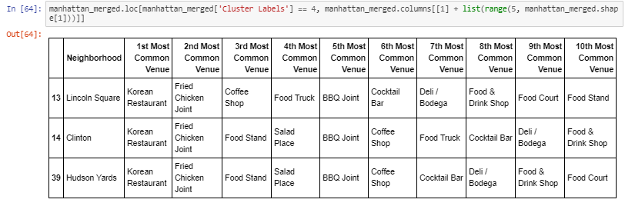
Cluster Label 4

Slide 15
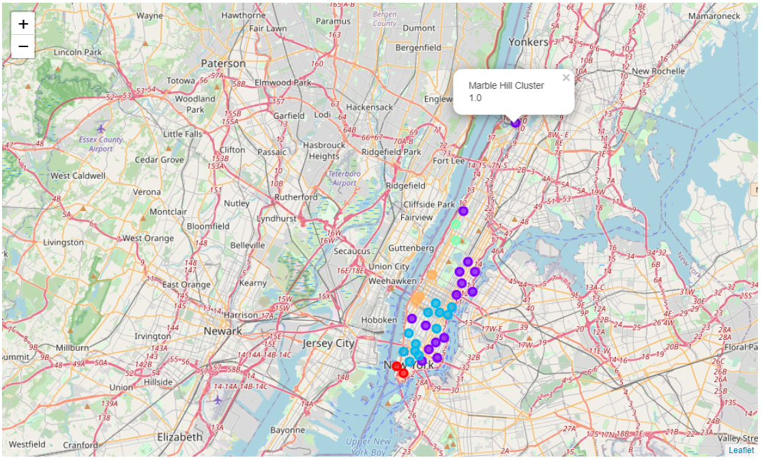
Results
Maps showing clusters of neighborhoods having Korean Restaurants, using K-means algorithm with K=5.

Slide 16
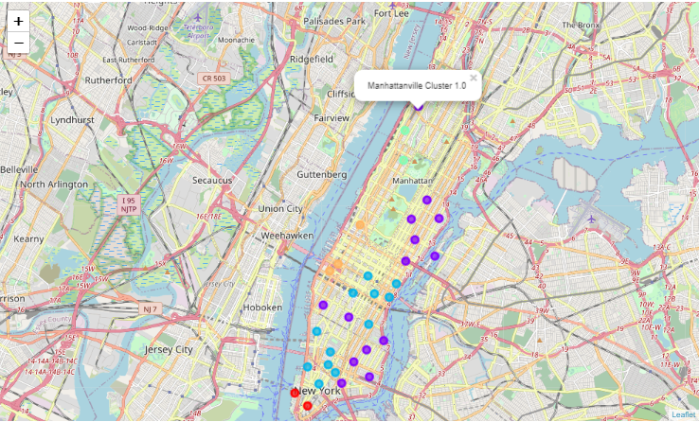
As per the analysis, we see that the best places to open Korean restaurants would be Marble Hill and Manhattanville (Cluster 1.0), also Manhattan Valley (Cluster 3.0) could also be ideal neighborhood since these are away from the neighborhoods with large number of Korean Restaurants, hence lesser competition from these counterparts.

Slide 17
Discussion
This analysis is performed on limited data. The results may vary and can depend on several factors such as population density in the area, transportation, demographics, etc. But if good amount of data is available there is scope to come up with better and more accurate results.
There is high competition in Chinatown and Soho so it is very risky to open business in these areas.
More detailed analysis by adding other factors such as population density, transportation, demographics of inhabitants.
It can be inferred that Korean food is very popular cuisine in Manhattan, could be due to high influx of Korean population and that people appreciate the cuisine.
So Korean food businesses are good business ventures and can generate good revenue if opened in best neighborhoods favoring the cuisine.

Slide 18
Conclusion
Through data science capstone project for predicting the best neighborhoods for opening Korean restaurants in Manhattan, New York, the required outcome is achieved and demonstrated.
We have been successfully able to incorporate data science concepts such as K-means algorithm for clustering, maps and Foursquare API to analyze and predict the neighborhoods which can be considered to open up the Korean restaurant business.
Although all of the goals of this project were met there is definitely room for improvement and development.
Using this idea, one can determine the suitable locations for setting up any business model by analyzing the demographical, geographical and other various different data sources of the location.

Slide 19
Thankyou

